Slide 1
Intro to the Tidyverse and importing/cleaning tables
Raphael Eisenhofer
2022_04_07

Slide 2
Outline for today:
1. Intro to the Tidyverse
2. Importing table data into R (excel, tsv, csv, etc.)
3. Cleaning data

Slide 3
1. The Tidyverse

Slide 4


The Tidyverse
Group of R packages designed for data science
Common design/grammar structures
More user friendly than base R
Wickham et al., (2019). Welcome to the Tidyverse. Journal of Open Source Software, 4(43), 1686, https://doi.org/10.21105/joss.01686

Slide 5

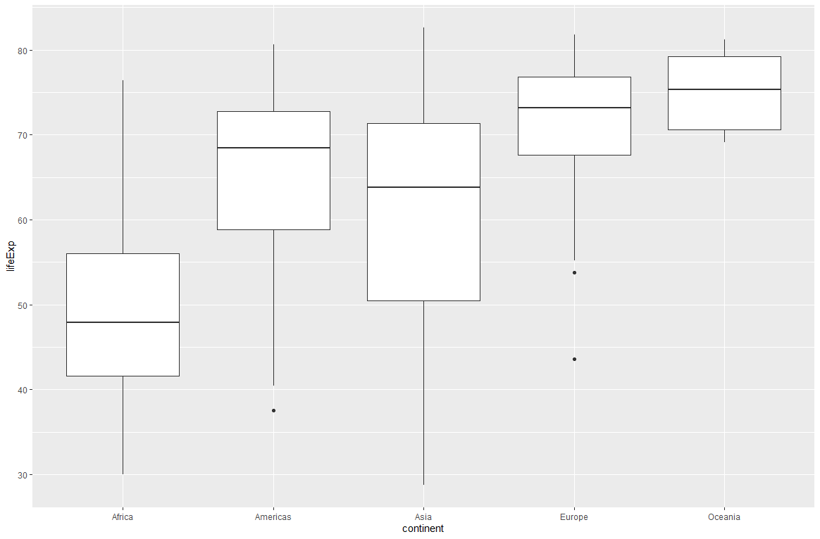

ggplot2

Slide 6
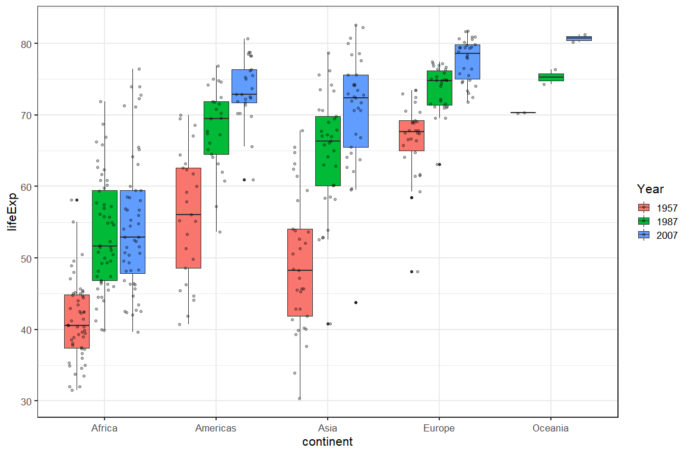

ggplot2

Slide 7
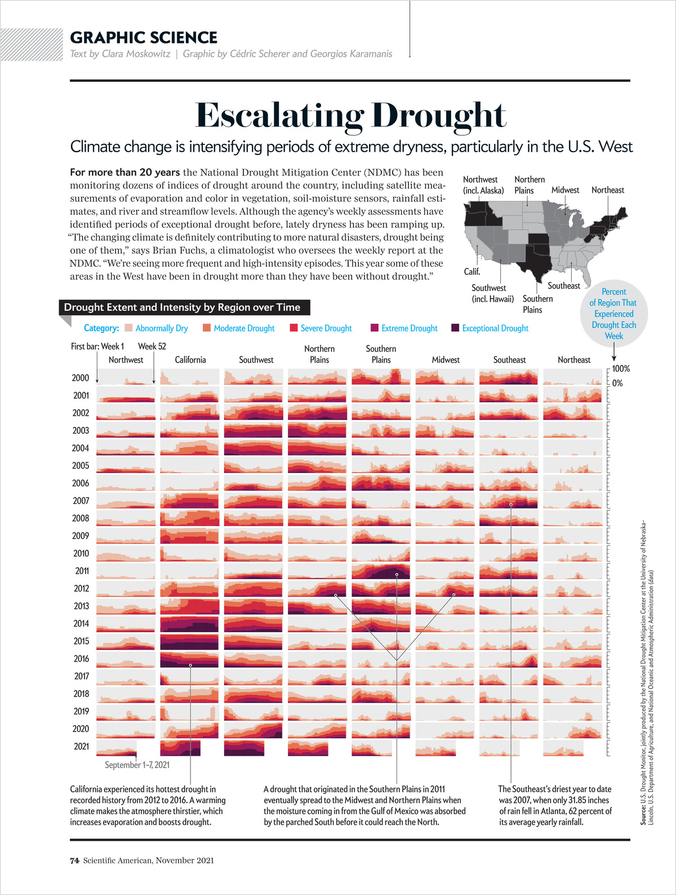

ggplot2
https://www.cedricscherer.com/top/dataviz/

Slide 8
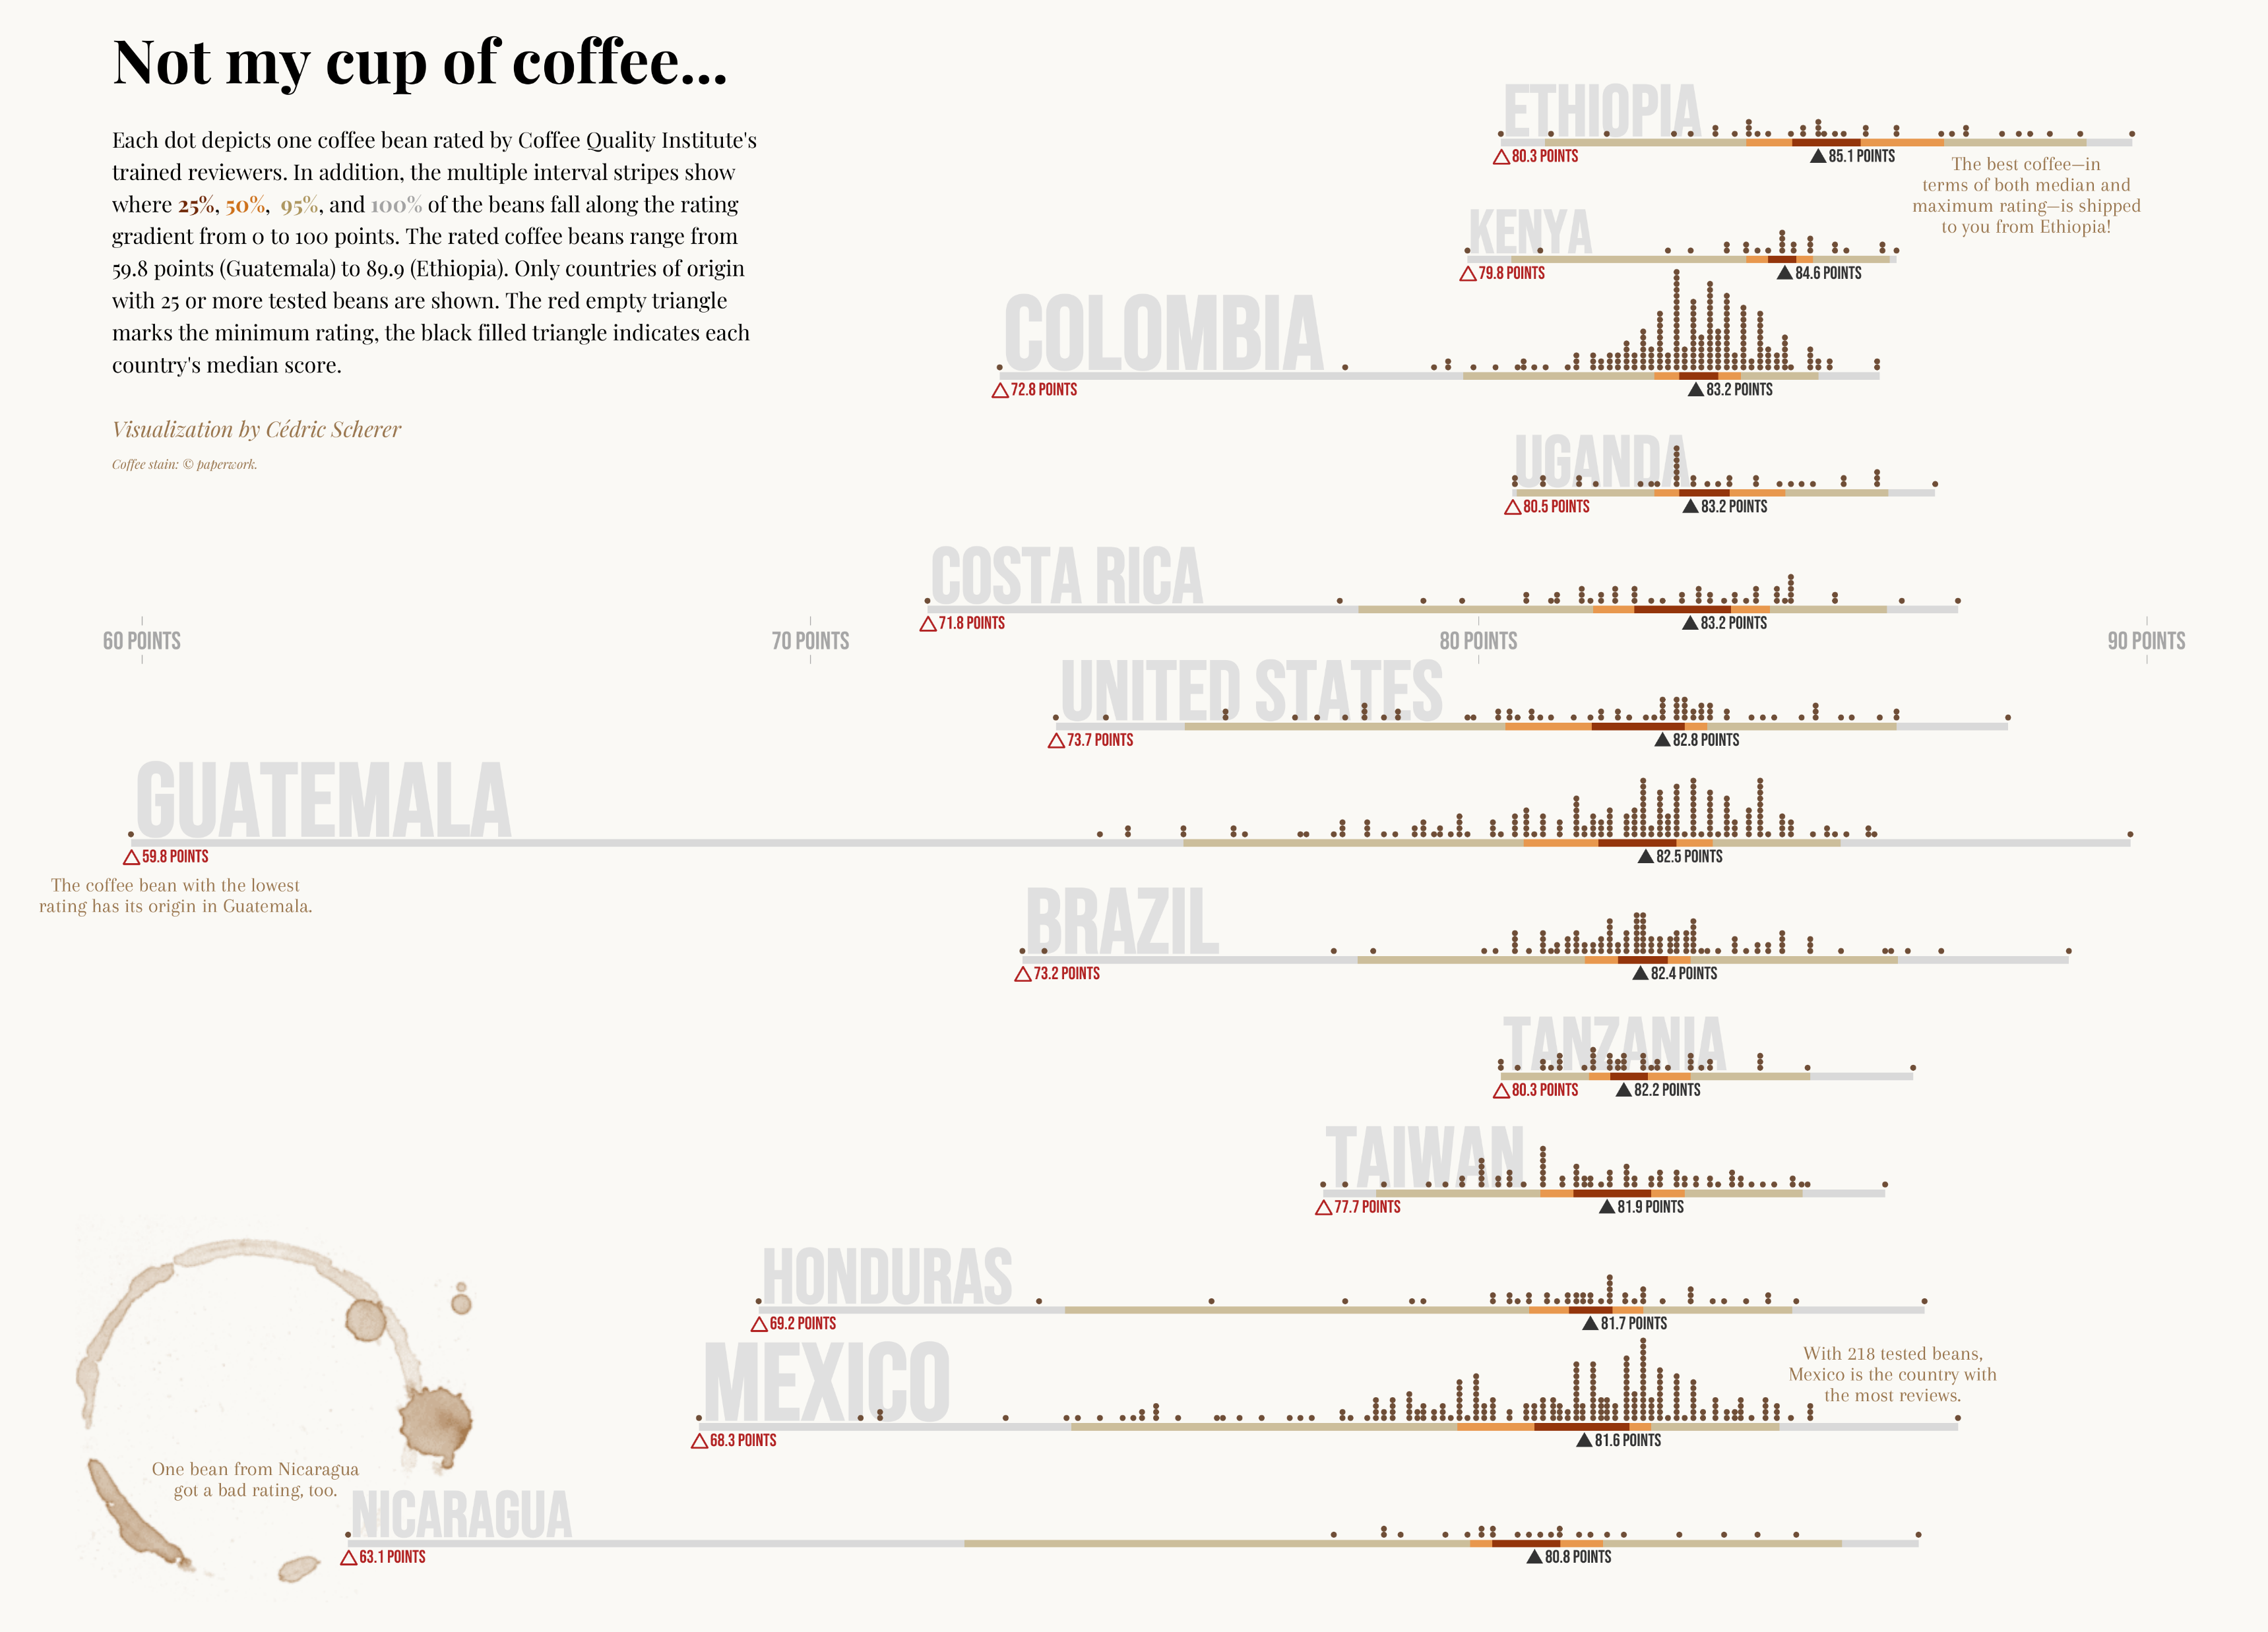
ggplot2
https://www.cedricscherer.com/top/dataviz/

Slide 9

ggplot2
https://www.cedricscherer.com/top/dataviz/

Slide 10

Pipes! %>%
Sends the output of one function to the input of another

Slide 11
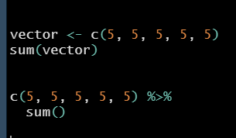
Pipes! %>%
Sends the output of one function to the input of another

Slide 12

Pipes! %>%
Sends the output of one function to the input of another
Create vector
Sum()
%>%

Slide 13
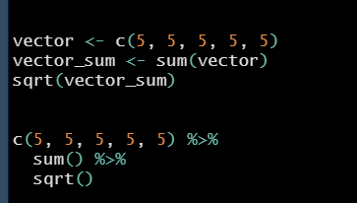
Pipes! %>%
Can simplify code and make it more intuitive/readable

Slide 14
2. Importing table data into R

Slide 15
Data frames
A list of equal length vectors

Slide 16
Data frames
A list of equal length vectors
You can easily extract any column as a vector (dataframe$colname)

Slide 17
Data frames
A list of equal length vectors
You can easily extract any column as a vector (dataframe$colname)
Very commonly used in data analysis (rows = samples, columns = variables)
as.data.frame (base R)

Slide 18

tibble
tibble()
Tidyverse functions automatically import tabular data to tibbles
Provides a more succinct overview of your data!
Automatically prints the types of data for each column (e.g. chr, dbl)

Slide 19
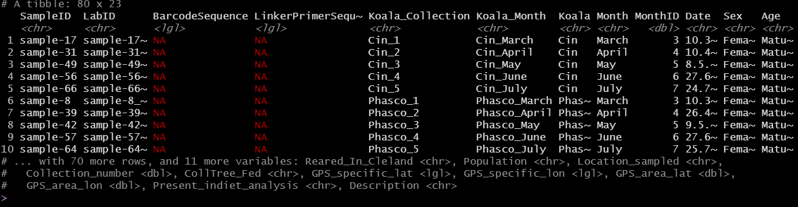
tibble
tibble()
Tidyverse functions automatically import tabular data to tibbles
Provides a more succinct overview of your data!
Automatically prints the types of data for each column (e.g. chr, dbl)

Slide 20

Functions for importing table data
read_xlsx()
read_xlsx(path = “path/to/your/table.xlsx”, sheet = “sheet1”)
Readxl cheatsheet: https://raw.githubusercontent.com/rstudio/cheatsheets/main/data-import.pdf

Slide 21

Functions for importing table data
read_delim()
read_delim(file = “path/to/your/file.filetype”, delim = ‘delimiter’)
Readr cheatsheet: https://raw.githubusercontent.com/rstudio/cheatsheets/main/data-import.pdf

Slide 22
Functions for importing table data
read_delim()
read_delim(file = “path/to/your/file.filetype”, delim = ‘delimiter’)
Common delimiters:
comma separated (.csv) delim = ‘,’
tab separated (.tsv) delim = ‘\t’
Readr cheatsheet: https://raw.githubusercontent.com/rstudio/cheatsheets/main/data-import.pdf

Slide 23
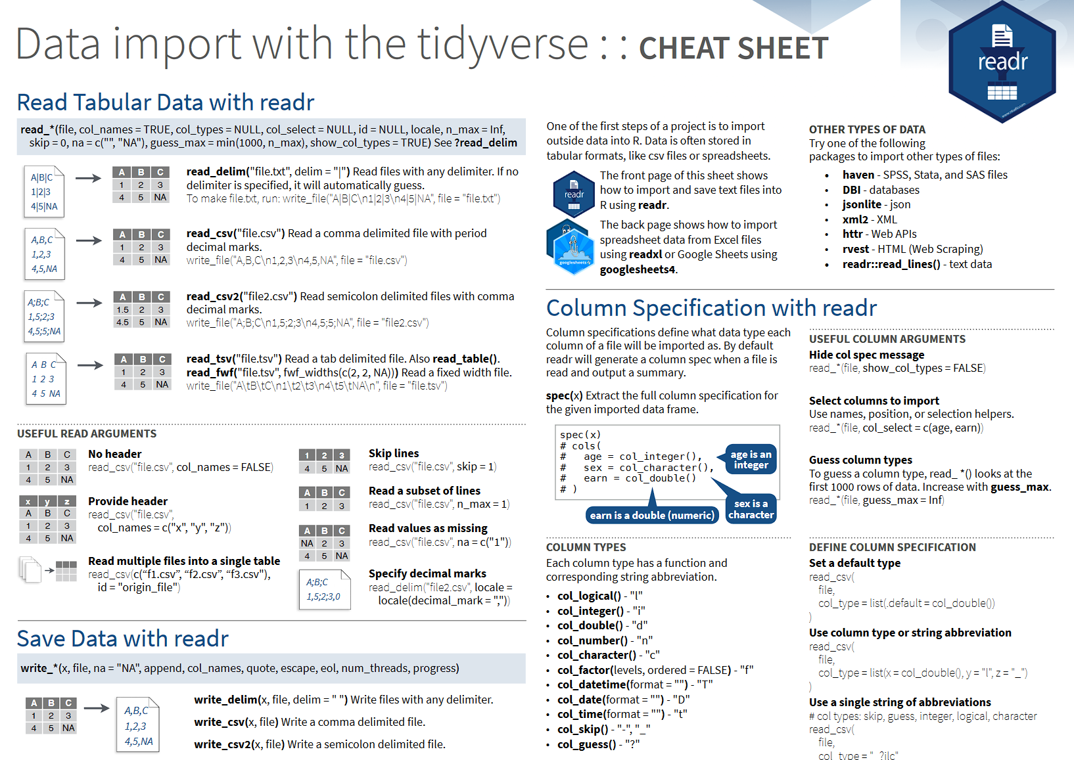

Slide 24


Slide 25
3. Cleaning table data

Slide 26
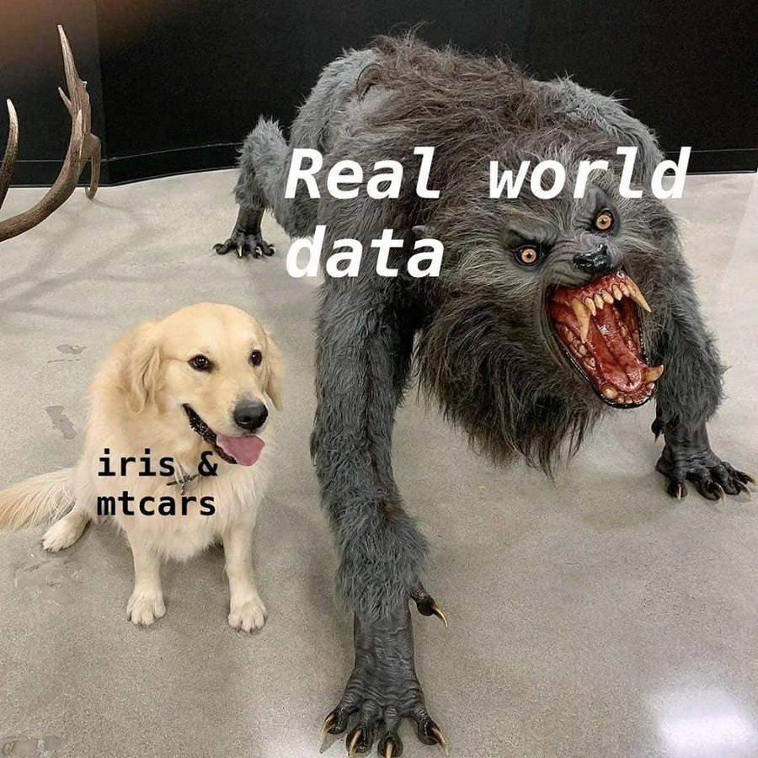

Slide 27

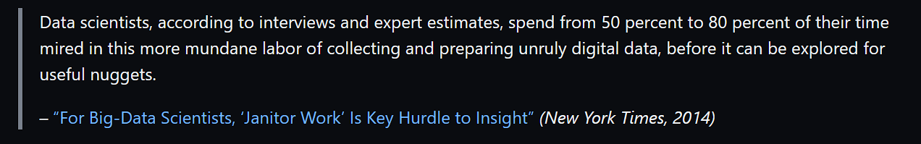
Janitor
https://www.nytimes.com/2014/08/18/technology/for-big-data-scientists-hurdle-to-insights-is-janitor-work.html

Slide 28
Janitor
clean_names()
As the name suggests! E.g. SaMpLe.NaMe% -> sample.name

Slide 29
Janitor
clean_names()
As the name suggests! E.g. SaMpLe.NaMe% -> sample.name
remove_empty()
Removes empty columns

Slide 30
Janitor
clean_names()
As the name suggests! E.g. SaMpLe.NaMe% -> sample.name
remove_empty()
Removes empty columns
remove_constant()
Removes useless columns

Slide 31
Janitor
clean_names()
As the name suggests! E.g. SaMpLe.NaMe% -> sample.name
remove_empty()
Removes empty columns
remove_constant()
Removes useless columns
get_dupes()
Finds duplicate entries (rows)

Slide 32

Dplyr
distinct()
Prints only distinct rows in a data frame

Slide 33
Exercise time!
See the exercises in “Exercises.R”

Slide 34
Summary
The Tidyverse
Importing data into R
Cleaning data

